Slide 1
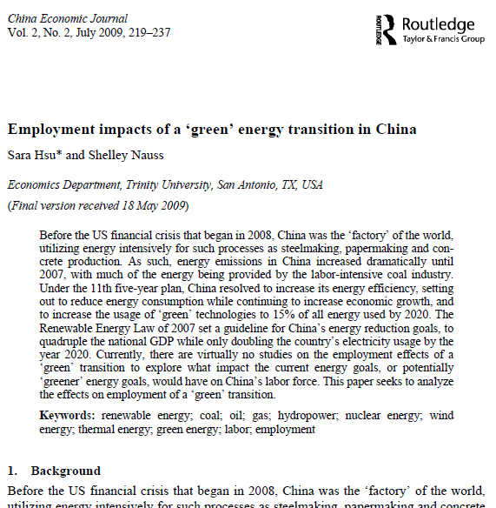
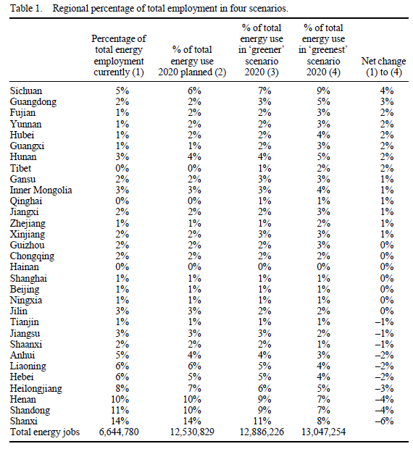
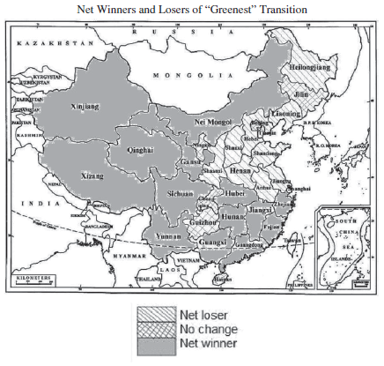
Case Study Four: Employment Impacts of A Green Energy Transition
Sara Hsu & Shelley Nauss (2009) Employment impacts of a ‘green’ energy
transition in China, China Economic Journal, 2:2, 219-237, DOI: 10.1080/17538960903083533
Objectives: To predict change in employments due to China’s transition into greener energy sources
Data Sources
China Data Online
China Industrial Yearbooks (2000-2008)
China Energy Portal
Data
Mean and Coefficient of Variation Within Regional/Sectoral Employment (China Industrial Yearbooks)
Regional Energy Employment (China Data Online)
Energy Production (1995-2006) (China Data Online)
Cumulative installed solar capacity (China Energy Portal)
Cumulative installed wind capacity (2012) (LINK)
Energy Production Distribution According to Four Scenarios (Hsu 2009)
Multiple energy employment data for each energy sectors (China Data Online)

Slide 2
Case Study Four: Employment Impacts of A Green Energy Transition
Methodology
From the distribution of jobs and energy production each energy from historical data, the distribution of jobs in 2020 under the 11th year plan is calculated. Then, from ‘greener’ and ‘greenest’ scenarios, the effects of a hypothetical energy industry transformation on job creation and destruction is estimated.
Flowchart
Data Inputs
Data Analysis
Outputs
Data Extraction from CDI and China Industrial Yearbook
Mean Distribution of Employment
Distribution of Employment in Four Scenarios
Tables
Bar Chart
Regional Energy Employment
China ESRI ShapeFile
Map

Slide 3
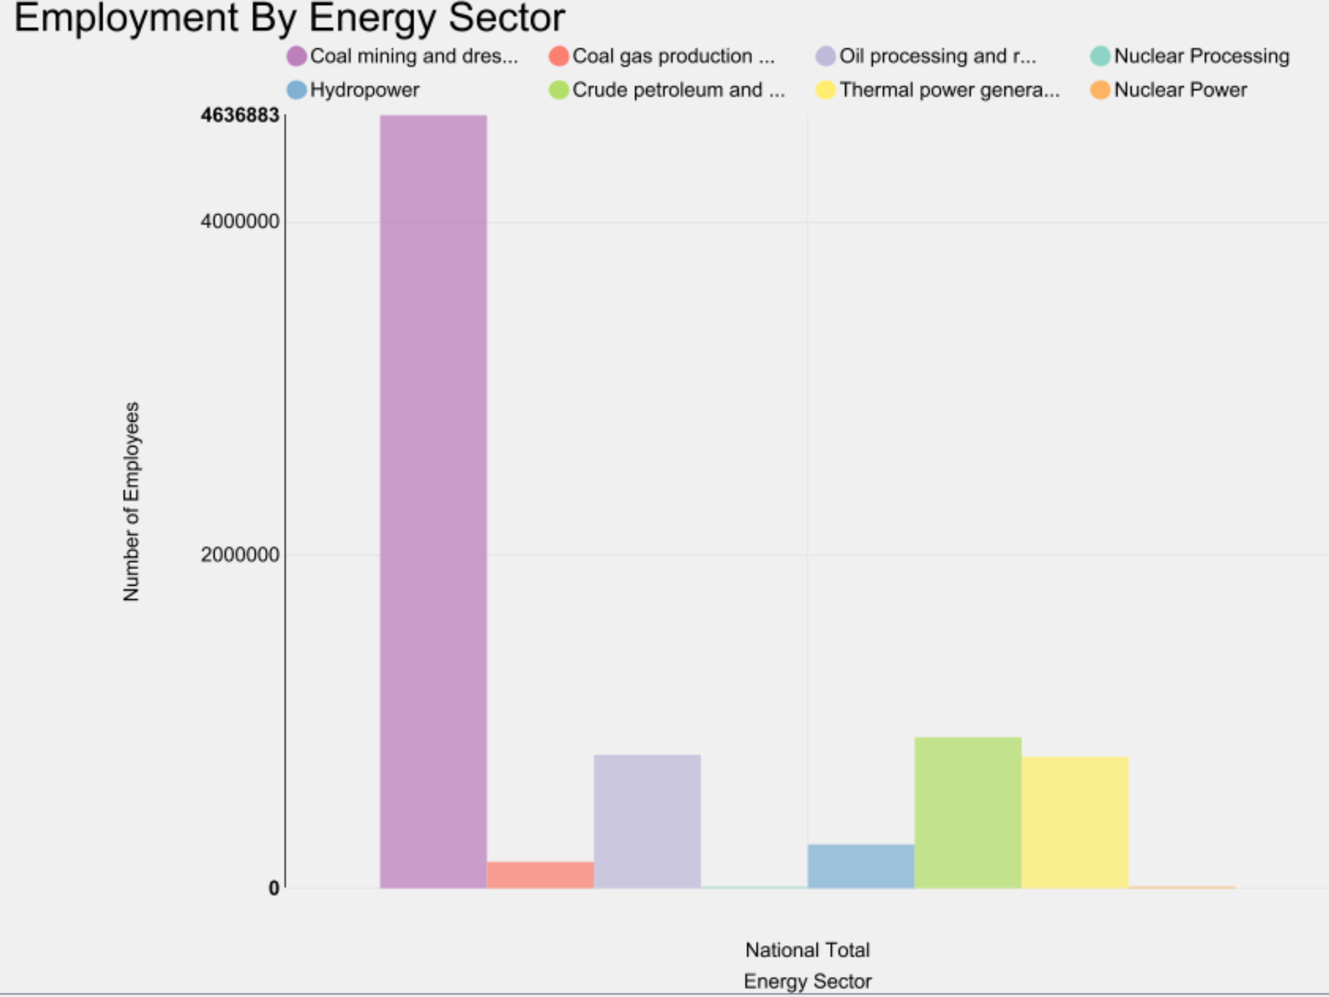
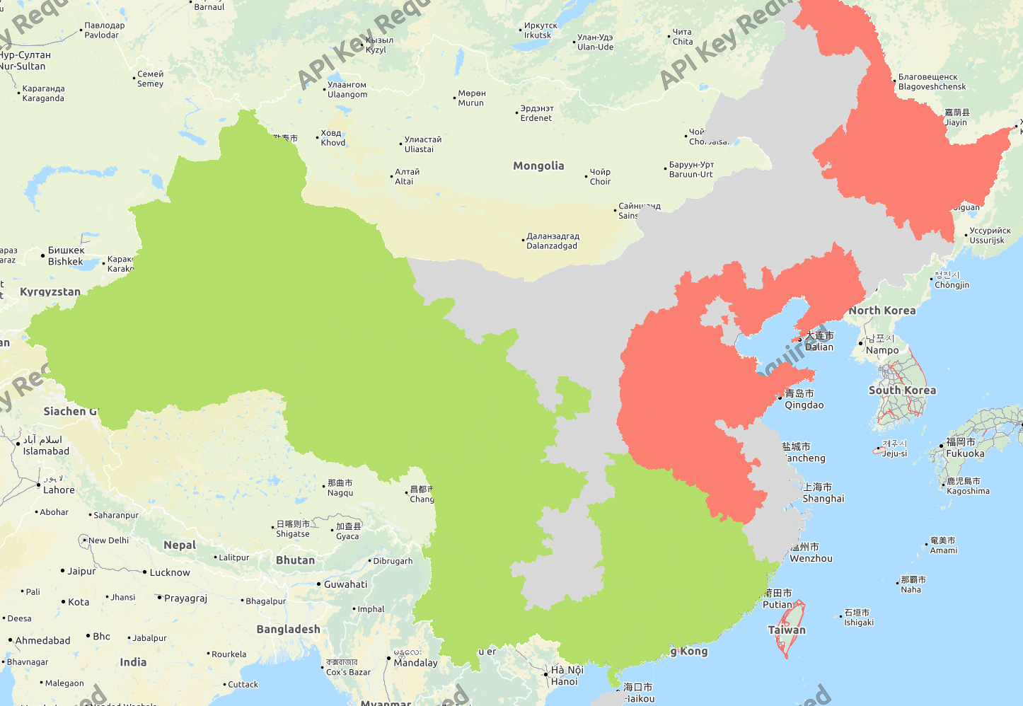
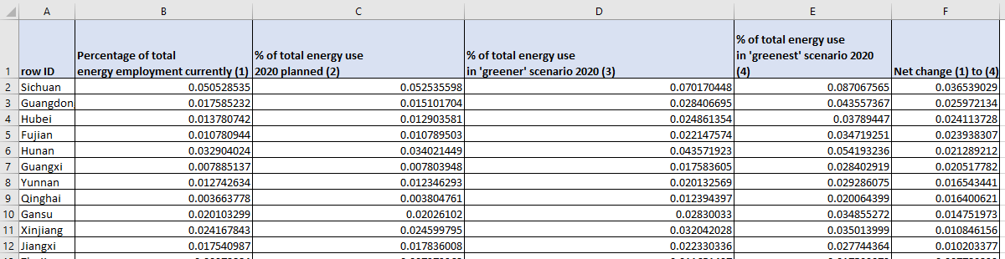
Case Study Four: Employment Impacts of A Green Energy Transition
Outputs from the Workflow
Employment By Energy Sector
Net Winners and Losers of “Greenest” Transition
Red: Provinces with a significant employment distribution loss
Gray: Provinces with small or no change in employment distribution
Green: Provinces with a significant employment distribution gain
Regional percentage of total employment in four scenarios

Slide 4
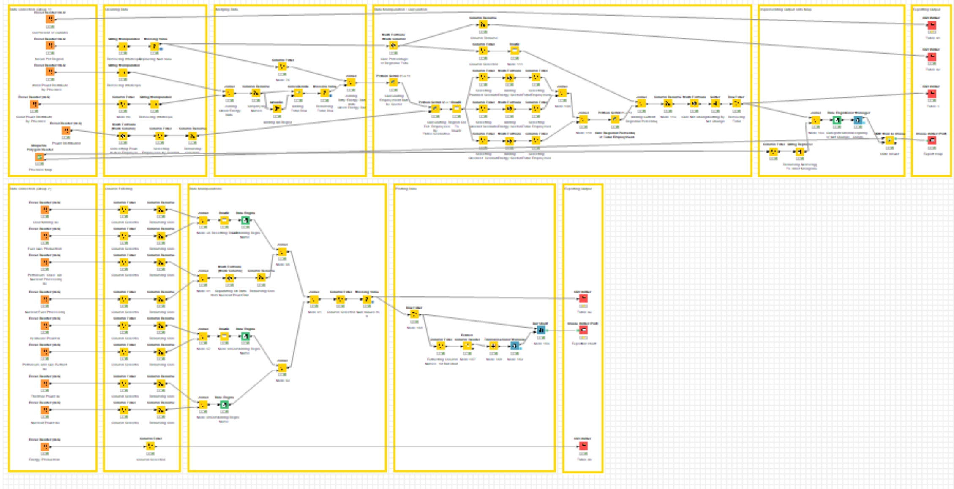
Case Study Four: Employment Impacts of A Green Energy Transition

Slide 5
Case Study Four: Employment Impacts of A Green Energy Transition
Steps for Running the Workflow
Step 1: Download data and unzip from https://drive.google.com/drive/folders/1OX-G2w6nSDVuVKEkrQ4EwZ5UhhNkmCLB?usp=sharing
Step 2: Download workflow from https://drive.google.com/drive/folders/1OX-G2w6nSDVuVKEkrQ4EwZ5UhhNkmCLB?usp=sharing
Step 3: Open KNIME from local PC or China Data Lab Cloud Platform (in building)
Step 4: Import KNIME workflow file (Employment Impacts of a Energy Transition.knwf)
Step 5: Configure all nodes in “data collection”
Step 6: Configure all nodes in “exporting output”
Step 6: Click Run function from the top menu
Step 7: Display the outputs:
Coefficient of variation (A1).csv
Mean Employment (A2).csv
Regional percentage of total employment in four scenarios.csv
Employment Map.png
Regional energy employment (A3).csv
Regional Employment Bar Chart.png
Energy Production.csv

Slide 6
Summary and Limitation
Summary
The workflow replicates the paper’s main parts and visualize the results in forms of tables, charts, and a map.
From the results, it is found that east regions of China will experience increase in employment distribution due to green energy transition. And west regions of China will experience decrease in employment distribution due to its heavy reliance on conventional ‘dirty’ energies.
Overall, China’s transition towards greener energy production will increase the total employment.
Limitation
The data of solar and wind power distribution by region in 2008 couldn’t be accessed directly. The data was replaced by cumulative energy production data from 2012. Additionally, original data from China Industrial Yearbook can’t be accessed directly. Instead, the workflow uses the data that is pulled directly from the paper. Due to the differences of the data, the outputs of the workflow slightly differ from that of the paper.

Slide 7
References
Sara Hsu & Shelley Nauss (2009) Employment impacts of a ‘green’ energy transition in China, China Economic Journal, 2:2, 219-237, DOI: 10.1080/17538960903083533
China Data Online https://www.china-data-online.com/
China Energy Portal https://chinaenergyportal.org/en/2018-q12-pv-installations-utility-and-distributed-by-province/
Zhang, X.; Wang, D.; Liu, Y.; Yi, H. Wind Power Development in China: An Assessment of Provincial Policies. Sustainability 2016, 8, 734.

